Slide 1
Data Mining: DWH and OLAP
1
Notes:
1

Slide 2
Chapter 4: Data Warehousing and On-line Analytical Processing
Data Warehouse: Basic Concepts
Data Warehouse Modeling: Data Cube and OLAP
Data Warehouse Design and Usage
Summary

Slide 3
Learning Outcomes
Define the characteristics of a data warehouse
Design a simple data warehouse schema using fact and dimension tables
Perform the OLAP operations on a data cube

Slide 4
What is a Data Warehouse?
Defined in many different ways, but not rigorously.
A decision support database that is maintained separately from the organization’s operational database
Support information processing by providing a solid platform of consolidated, historical data for analysis.
“A data warehouse is a subject-oriented, integrated, time-variant, and nonvolatile collection of data in support of management’s decision-making process.”—W. H. Inmon
Data warehousing:
The process of constructing and using data warehouses

Slide 5
Data Warehouse—Subject-Oriented
Organized around major subjects, such as customer, product, sales
Focusing on the modeling and analysis of data for decision makers, not on daily operations or transaction processing
Provide a simple and concise view around particular subject issues by excluding data that are not useful in the decision support process

Slide 6
Data Warehouse—Integrated
Constructed by integrating multiple, heterogeneous data sources
relational databases, flat files, on-line transaction records
Data cleaning and data integration techniques are applied.
Ensure consistency in naming conventions, encoding structures, attribute measures, etc. among different data sources
E.g., Hotel price: currency, tax, breakfast covered, etc.
When data is moved to the warehouse, it is converted.

Slide 7
Data Warehouse—Time Variant
The time horizon for the data warehouse is significantly longer than that of operational systems
Operational database: current value data
Data warehouse data: provide information from a historical perspective (e.g., past 5-10 years)
Every key structure in the data warehouse
Contains an element of time, explicitly or implicitly
But the key of operational data may or may not contain “time element”

Slide 8
Data Warehouse—Nonvolatile
A physically separate store of data transformed from the operational environment
Operational update of data does not occur in the data warehouse environment
Does not require transaction processing, recovery, and concurrency control mechanisms
Requires only two operations in data accessing:
initial loading of data and access of data

Slide 9
OLTP vs. OLAP
OLTP: Online transactional processing
DBMS operations
Query and transactional processing
OLAP: Online analytical processing
Data warehouse operations
Drilling, slicing, dicing, etc.

Slide 10
Why a Separate Data Warehouse?
High performance for both systems
DBMS— tuned for OLTP: access methods, indexing, concurrency control, recovery
Warehouse—tuned for OLAP: complex OLAP queries, multidimensional view, consolidation
Different functions and different data:
missing data: Decision support requires historical data which operational DBs do not typically maintain
data consolidation: DS requires consolidation (aggregation, summarization) of data from heterogeneous sources
data quality: different sources typically use inconsistent data representations, codes and formats which have to be reconciled
Note: There are more and more systems which perform OLAP analysis directly on relational databases

Slide 11
Data Warehouse: A Multi-Tiered Architecture
Top Tier: Front-End Tools
Middle Tier: OLAP Server
Bottom Tier: Data Warehouse Server
Data

Slide 12
Three Data Warehouse Models
Enterprise warehouse
collects all of the information about subjects spanning the entire organization
Data Mart
a subset of corporate-wide data that is of value to a specific groups of users.
Its scope is confined to specific, selected groups, such as marketing data mart
Independent vs. dependent (directly from warehouse) data mart
Virtual warehouse
A set of views over operational databases
Only some of the possible summary views may be materialized

Slide 13
Extraction, Transformation, and Loading (ETL)
Data extraction
get data from multiple, heterogeneous, and external sources
Data cleaning
detect errors in the data and rectify them when possible
Data transformation
convert data from legacy or host format to warehouse format
Load
sort, summarize, consolidate, compute views, check integrity, and build indicies and partitions
Refresh
propagate the updates from the data sources to the warehouse
Notes:
MK 08.11.09 Former title: Data Warehouse Back-End Tools and Utilities

Slide 14
Metadata Repository
Meta data is the data defining warehouse objects. It stores:
Description of the structure of the data warehouse
schema, view, dimensions, hierarchies, derived data defn, data mart locations and contents
Operational meta-data
data lineage (history of migrated data and transformation path), currency of data (active, archived, or purged), monitoring information (warehouse usage statistics, error reports, audit trails)
The algorithms used for summarization
The mapping from operational environment to the data warehouse
Data related to system performance
warehouse schema, view and derived data definitions
Business data
business terms and definitions, ownership of data, charging policies

Slide 15
Chapter 4: Data Warehousing and On-line Analytical Processing
Data Warehouse: Basic Concepts
Data Warehouse Modeling: Data Cube and OLAP
Data Warehouse Design and Usage
Summary

Slide 16
From Tables and Spreadsheets to Data Cubes
A data warehouse is based on a multidimensional data model which views data in the form of a data cube
A data cube, such as sales, allows data to be modeled and viewed in multiple dimensions
Dimension tables, such as item (item_name, brand, type), or time(day, week, month, quarter, year)
Fact table contains measures (such as dollars_sold) and keys to each of the related dimension tables

Slide 17
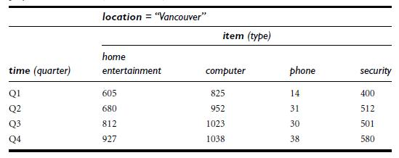
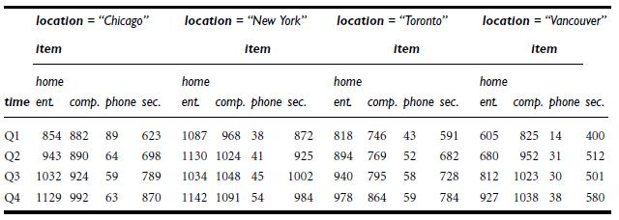
2-D Vs 3-D View

Slide 18
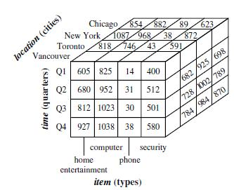
3-D View and 3-D Cube

Slide 19
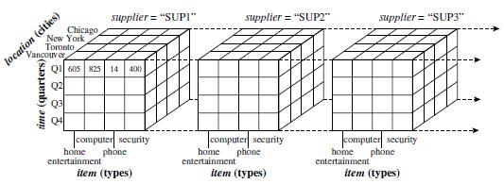
3-D Vs 4-D Cube

Slide 20
Exercise 1
Identify the dimensions and facts from the following attributes:
Time, Location, Item Type, Supplier, Items Sold, Dollars Sold
Create a lattice for all the dimensions
Give an example of apex cuboid query
Give an example of query on 3 dimensions
Give an example of n-d cuboid query

Slide 21
Exercise 1
Identify the dimensions and facts from the following attributes:
Time, Location, Item Type, Supplier, Items Sold, Sales amount
Dimensions
Time, Location, Item Type, Supplier
Facts
Items sold, Sales amount

Slide 22
Cube: A Lattice of Cuboids (can be used for any fact)
all
0-D (apex) cuboid
time
item
location
supplier
1-D cuboids
time,location
item,location
location,supplier
time,item
2-D cuboids
time,supplier
item,supplier
time,location,supplier
3-D cuboids
time,item,location
time,item,supplier
item,location,supplier
4-D (base) cuboid
time, item, location, supplier

Slide 23
Cuboids and Cubes
In data warehousing literature,
an n-D base cube is called a base cuboid
The top most 0-D cuboid, which holds the highest-level of summarization, is called the apex cuboid
The lattice of cuboids forms a data cube.

Slide 24
Exercise 1
Give an example of apex cuboid query
There is only one possible query: How many sales/item sold were there for all the time, all the item types, all the locations, and all the suppliers (answer will be just one number which is sum of all the fact numbers)
Give an example of query on 3 dimensions
E.g., for 3 dimension time, location, and item type, the query can be: how many items were sold in Q1, in Chicago, of Phones?
Give an example of n-d cuboid query
It will combine all (4) dimensions e.g.,: how many items were sold in Q3, in New York, of Computers, by Supplier 3?

Slide 25
Conceptual Modeling of Data Warehouses
Modeling data warehouses: dimensions & measures
Star schema: A fact table in the middle connected to a set of dimension tables
Snowflake schema: A refinement of star schema where some dimensional hierarchy is normalized into a set of smaller dimension tables, forming a shape similar to snowflake
Fact constellations: Multiple fact tables share dimension tables, viewed as a collection of stars, therefore called galaxy schema or fact constellation

Slide 26



Star, Snowflake and Constellation

Slide 27
Example of Star Schema
time
time_key
day
day_of_the_week
month
quarter
year
item
item_key
item_name
brand
type
supplier_type
Sales Fact Table
time_key
item_key
branch_key
branch
location
location_key
branch_key
branch_name
branch_type
location_key
street
city
state_or_province
country
units_sold
dollars_sold
avg_sales
Measures

Slide 28
Example of Snowflake Schema
time
item
time_key
day
day_of_the_week
month
quarter
year
item_key
item_name
brand
type
supplier_key
supplier
Sales Fact Table
supplier_key
supplier_type
time_key
item_key
branch_key
branch
location
location_key
location_key
street
city_key
branch_key
branch_name
branch_type
units_sold
dollars_sold
city
city_key
city
state_or_province
country
avg_sales
Measures

Slide 29
Example of Fact Constellation
time
time_key
day
day_of_the_week
month
quarter
year
item
Shipping Fact Table
item_key
item_name
brand
type
supplier_type
Sales Fact Table
time_key
time_key
item_key
shipper_key
item_key
branch_key
from_location
branch
location_key
location
to_location
branch_key
branch_name
branch_type
units_sold
location_key
street
city
province_or_state
country
dollars_cost
dollars_sold
units_shipped
avg_sales
shipper
Measures
shipper_key
shipper_name
location_key
shipper_type

Slide 30
Exercise 2
Create a star schema for weather station with dimensions: time and location and facts: temperature, humidity, air pressure, and precipitation.

Slide 31
Exercise 2
Create a star schema for weather station with dimensions: time and location and facts: temperature, humidity, air pressure, and precipitation.
Time_id
Hour
Day
Week
Month
Year
Time_id
Location_id
Average Temperature
Average Humidity
Average Air Pressure
Average Precipitation
Location_id
City
Province Country

Slide 32
A Concept Hierarchy: Dimension (location)
all
all
region
Europe
...
North_America
country
Germany
...
Spain
Canada
...
Mexico
city
Frankfurt
...
Vancouver
...
Toronto
office
L. Chan
...
M. Wind

Slide 33
A Sample Data Cube
Date
Total annual sales
of TVs in U.S.A.
1Qtr
2Qtr
3Qtr
4Qtr
sum
Product
TV
PC
U.S.A
VCR
sum
Canada
Country
Mexico
sum
All, All, All

Slide 34
Typical OLAP Operations
Roll up (drill-up): summarize data
by climbing up hierarchy or by dimension reduction
Drill down (roll down): reverse of roll-up
from higher level summary to lower level summary or detailed data, or introducing new dimensions
Slice and dice: project and select
Pivot (rotate):
reorient the cube, visualization, 3D to series of 2D planes
Other operations
drill across: involving (across) more than one fact table
drill through: through the bottom level of the cube to its back-end relational tables (using SQL)

Slide 35
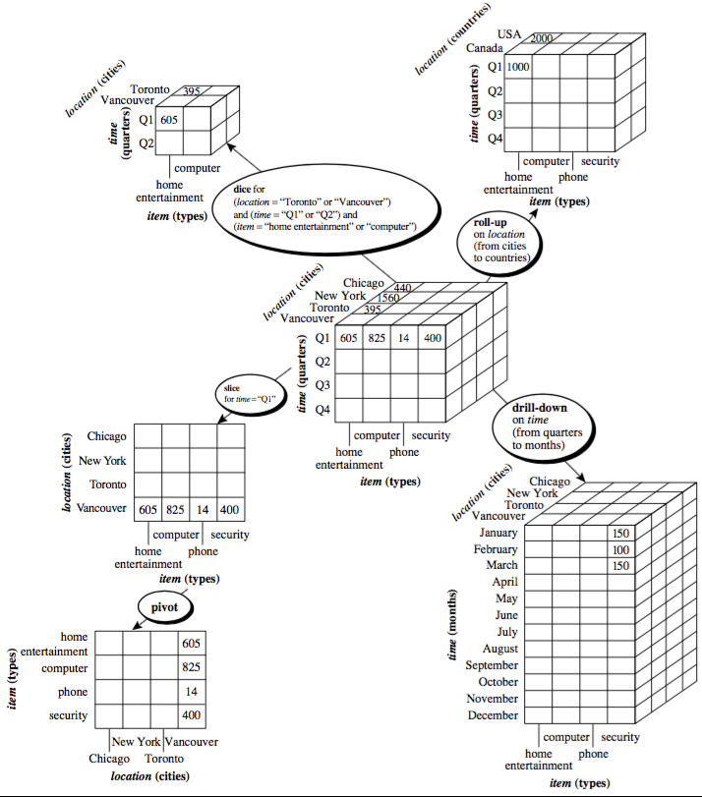

Slide 36
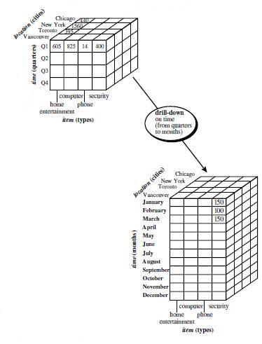
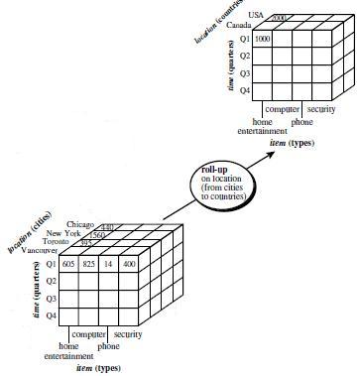
Roll-up and Drill-down

Slide 37
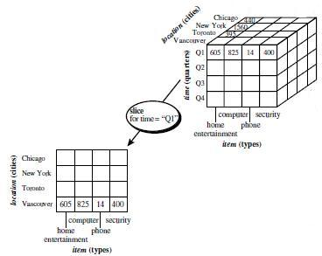
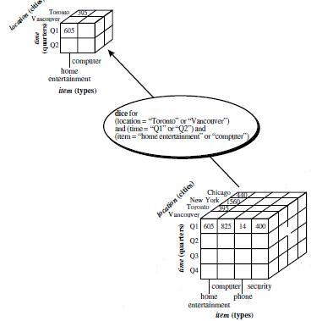
Slice and Dice

Slide 38
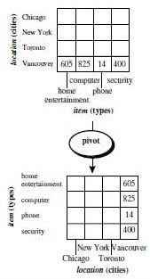
Pivot

Slide 39
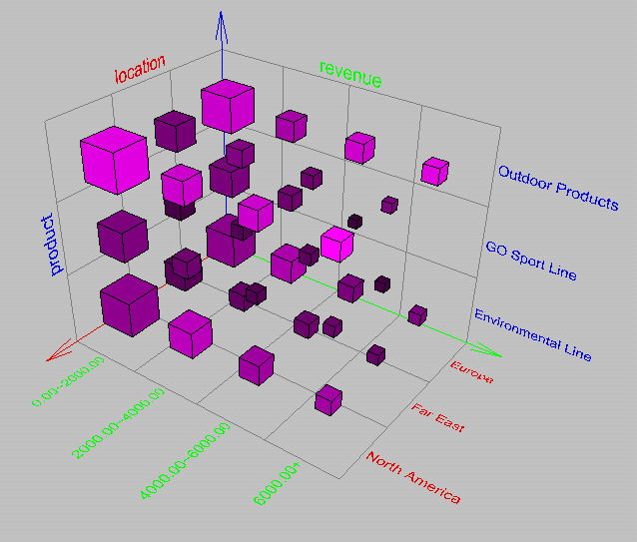
Browsing a Data Cube

Slide 40
Chapter 4: Data Warehousing and On-line Analytical Processing
Data Warehouse: Basic Concepts
Data Warehouse Modeling: Data Cube and OLAP
Data Warehouse Design and Usage
Summary

Slide 41
Data Warehouse Design Process
Top-down, bottom-up approaches or a combination of both
Top-down: Starts with overall design and planning (mature)
Bottom-up: Starts with experiments and prototypes (rapid)

Slide 42
Top down or bottom up?
Top down
pros: serves as systematic solution and minimizes integration problems
cons: expensive, long development time, lacks flexibility as a common data model for the entire organization is difficult to achieve
Bottom up
pros: flexible, low cost and rapid ROI
cons: integration problems

Slide 43
Data Warehouse Design Process
Typical data warehouse design process
Choose a business process to model, e.g., orders, invoices, etc.
Choose the grain (atomic level of data) of the business process, e.g. individual transactions, individual daily snapshots etc.
Choose the dimensions that will apply to each fact table record, e.g. time, item, customer, sales etc.
Choose the measure that will populate each fact table record, e.g., dollars sold, units sold etc

Slide 44
Data Warehouse Usage
Three kinds of data warehouse applications
Information processing
supports querying, basic statistical analysis, and reporting using crosstabs, tables, charts and graphs
Analytical processing
multidimensional analysis of data warehouse data
supports basic OLAP operations, slice-dice, drilling, pivoting
Data mining
knowledge discovery from hidden patterns
supports associations, constructing analytical models, performing classification and prediction, and presenting the mining results using visualization tools

Slide 45
From On-Line Analytical Processing (OLAP) to On Line Analytical Mining (OLAM)
Why online analytical mining?
High quality of data in data warehouses
DW contains integrated, consistent, cleaned data
OLAP-based exploratory data analysis
Mining with drilling, dicing, pivoting, etc.
On-line selection of data mining functions
Integration and swapping of multiple mining functions, algorithms, and tasks

Slide 46
Chapter 4: Data Warehousing and On-line Analytical Processing
Data Warehouse: Basic Concepts
Data Warehouse Modeling: Data Cube and OLAP
Data Warehouse Design and Usage
Summary

Slide 47
Summary
Data warehousing: A multi-dimensional model of a data warehouse
A data cube consists of dimensions & measures
Star schema, snowflake schema, fact constellations
OLAP operations: drilling, rolling, slicing, dicing and pivoting
Data Warehouse Architecture, Design, and Usage
Multi-tiered architecture
Business analysis design framework
Information processing, analytical processing, data mining, OLAM (Online Analytical Mining)

Slide 48
References (I)
S. Agarwal, R. Agrawal, P. M. Deshpande, A. Gupta, J. F. Naughton, R. Ramakrishnan, and S. Sarawagi. On the computation of multidimensional aggregates. VLDB’96
D. Agrawal, A. E. Abbadi, A. Singh, and T. Yurek. Efficient view maintenance in data warehouses. SIGMOD’97
R. Agrawal, A. Gupta, and S. Sarawagi. Modeling multidimensional databases. ICDE’97
S. Chaudhuri and U. Dayal. An overview of data warehousing and OLAP technology. ACM SIGMOD Record, 26:65-74, 1997
E. F. Codd, S. B. Codd, and C. T. Salley. Beyond decision support. Computer World, 27, July 1993.
J. Gray, et al. Data cube: A relational aggregation operator generalizing group-by, cross-tab and sub-totals. Data Mining and Knowledge Discovery, 1:29-54, 1997.
A. Gupta and I. S. Mumick. Materialized Views: Techniques, Implementations, and Applications. MIT Press, 1999.
J. Han. Towards on-line analytical mining in large databases. ACM SIGMOD Record, 27:97-107, 1998.
V. Harinarayan, A. Rajaraman, and J. D. Ullman. Implementing data cubes efficiently. SIGMOD’96

Slide 49
References (II)
C. Imhoff, N. Galemmo, and J. G. Geiger. Mastering Data Warehouse Design: Relational and Dimensional Techniques. John Wiley, 2003
W. H. Inmon. Building the Data Warehouse. John Wiley, 1996
R. Kimball and M. Ross. The Data Warehouse Toolkit: The Complete Guide to Dimensional Modeling. 2ed. John Wiley, 2002
P. O'Neil and D. Quass. Improved query performance with variant indexes. SIGMOD'97
Microsoft. OLEDB for OLAP programmer's reference version 1.0. In http://www.microsoft.com/data/oledb/olap, 1998
A. Shoshani. OLAP and statistical databases: Similarities and differences. PODS’00.
S. Sarawagi and M. Stonebraker. Efficient organization of large multidimensional arrays. ICDE'94
P. Valduriez. Join indices. ACM Trans. Database Systems, 12:218-246, 1987.
J. Widom. Research problems in data warehousing. CIKM’95.
K. Wu, E. Otoo, and A. Shoshani, Optimal Bitmap Indices with Efficient Compression, ACM Trans. on Database Systems (TODS), 31(1), 2006, pp. 1-38.

